Slide 1
Object - Oriented Programming
Lab #1

Slide 2
Context
Introduction
Install JDK
Install & Intro to Eclipse

Slide 3
Introduction
Assistant : 조광호, 이정훈
Office : Rm #805 ITBT
E-mail : whrhkdghekd@hanyang.ac.kr
jeonghunlee@hanyang.ac.kr

Slide 4
Schedule
Week 1: Course Overview & Getting Started
Week 2: Console Input and Output, Flow of Control
Week 3-5: Defining Classes
Week 6: Arrays
Week 7: Inheritance
Week 8(Midterm): Polymorphism and Abstract Classes
Week 9: Midterm Exam

Slide 5
Schedule
Week 10: Exception Handling
Week 11: File I/O
Week 12: UML and Patterns
Week 13: Interface and Inner Classes
Week 14: Generics and the ArrayList Class
Week 15: Wrap-up
Week 16: Final Exam

Slide 6
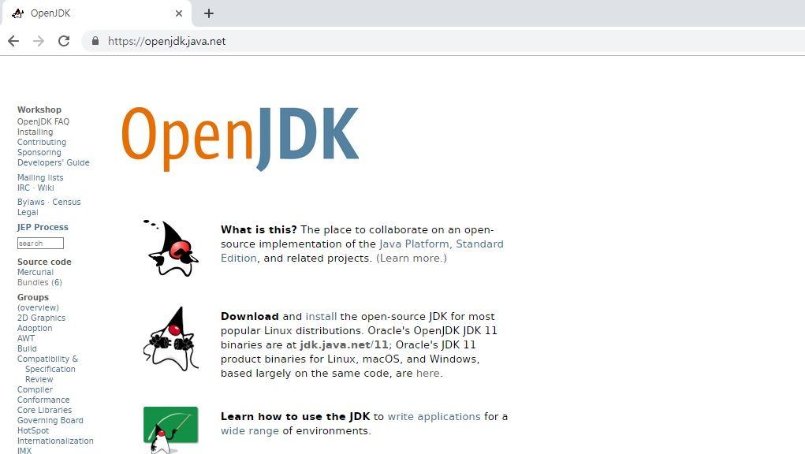
Install JDK
JDK : Java Development Kit
JRE : Java Runtime Environment
Go to OpenJDK home page and select installing menu
(OpenJDK : https://openjdk.java.net/)

Slide 7
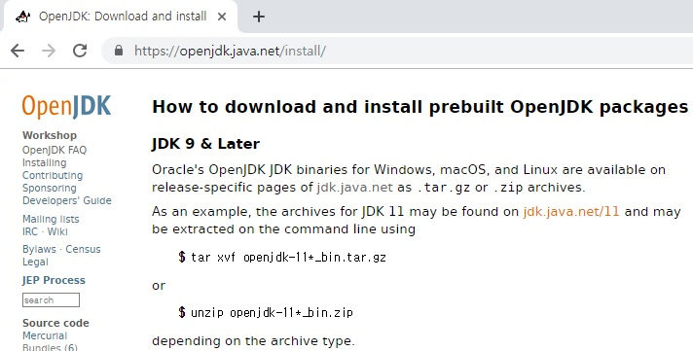
Install JDK
Select jdk.java.net/11

Slide 8
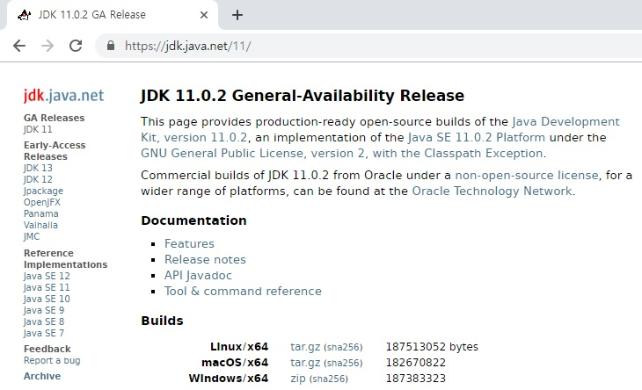
Install JDK
Select Windows/x64 zip and download the JDK

Slide 9
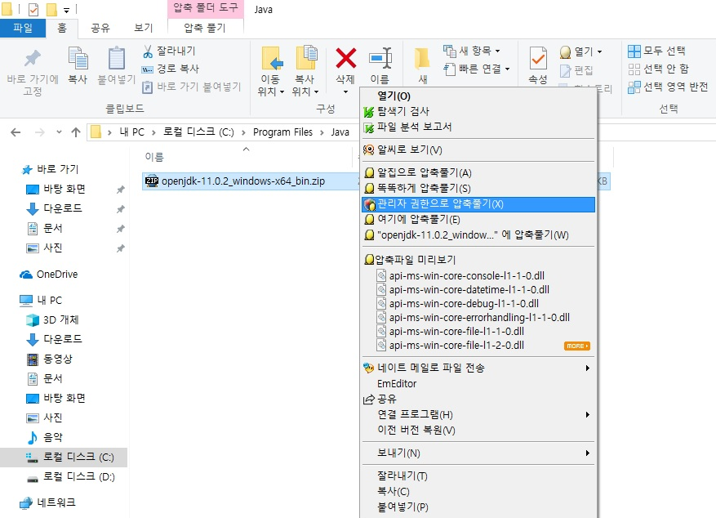
Install JDK
Create a folder in C:\Program-Files and unpack zip f-ile.

Slide 10
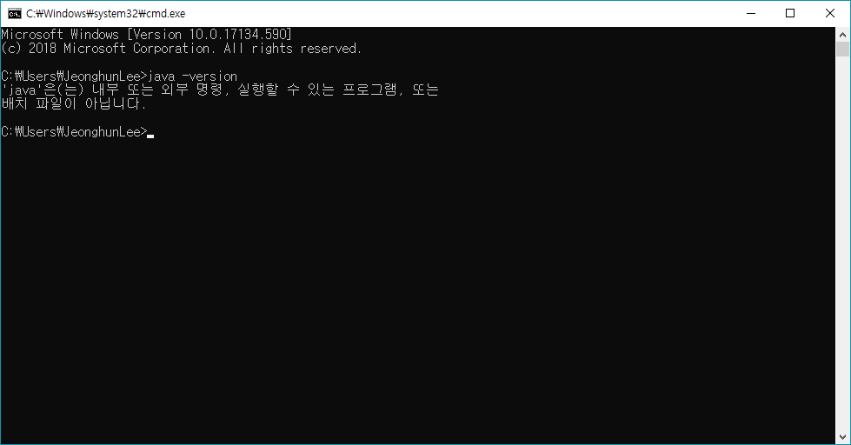
Install JDK
Check the java version in command window
java -version

Slide 11
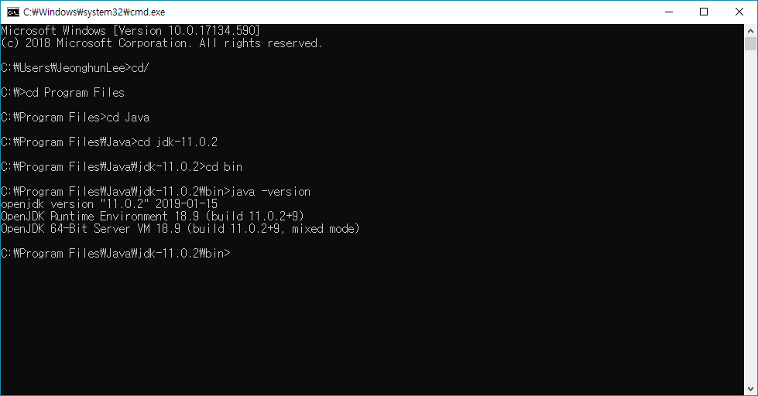
Install JDK
C:\Program Files\Java\jdk-11.0.2\bin
java -version

Slide 12
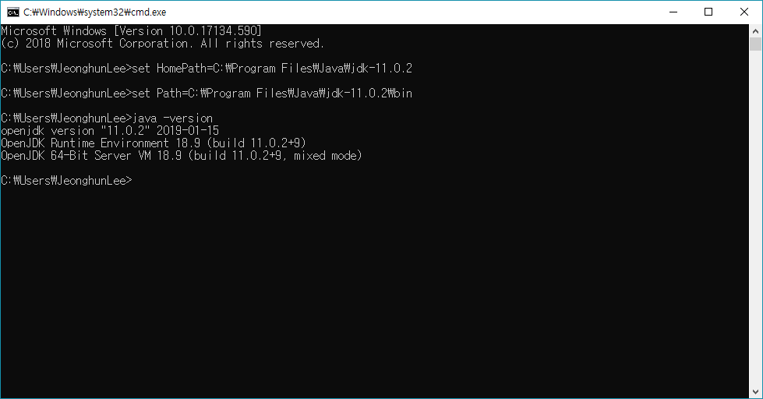
Install JDK
set HomePath=C:\Program Files\Java\jdk-11.0.2
set Path=C:\Program Files\Java\jdk-11.0.2\bin

Slide 13
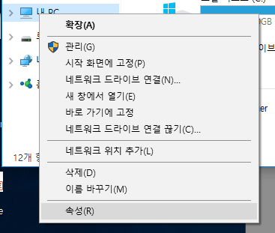
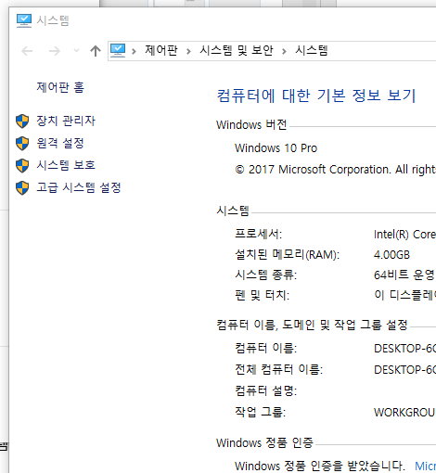
Add Java to the Windows Path
내PC 마우스 우클릭 → 속성 → 고급 시스템 설정

Slide 14
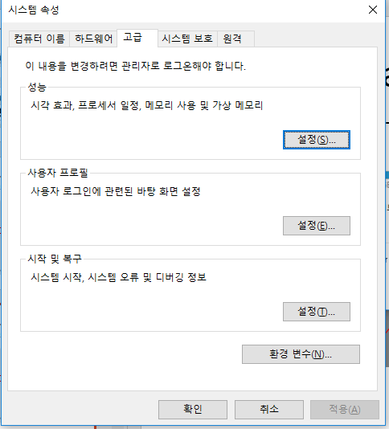
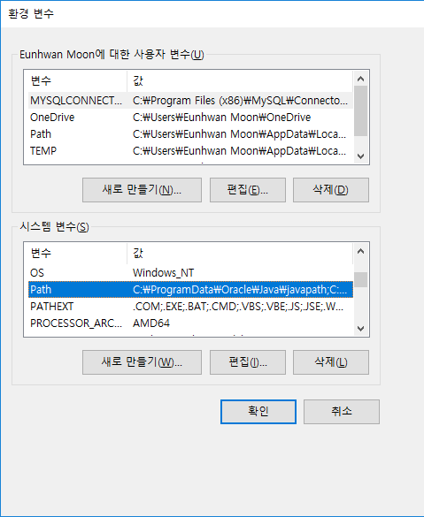
Add Java to the Windows Path
환경 변수 → 새로 만들기

Slide 15
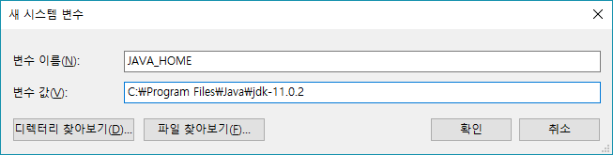
Add Java to the Windows Path
JAVA_HOME
C:\Program Files\Java\jdk-11.0.2 (자바 JDK 설치 경로)

Slide 16
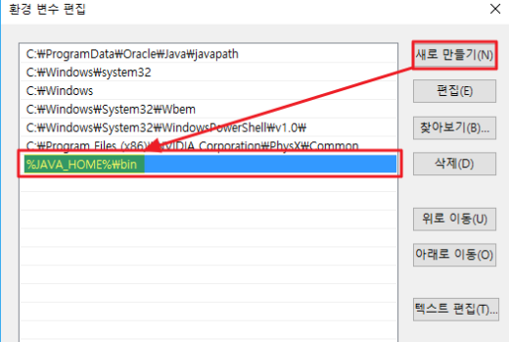
Add Java to the Windows Path
편집 → 새로 만들기 → %JAVA_HOME%\bin

Slide 17

Add Java to the Windows Path
Check the java version in command window
java -version

Slide 18
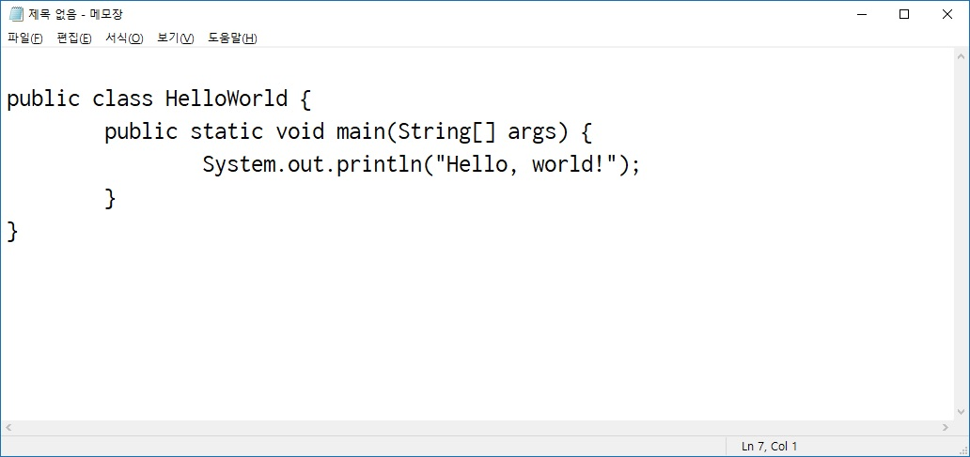
Add Java to the Windows Path
Enter Java source code

Slide 19
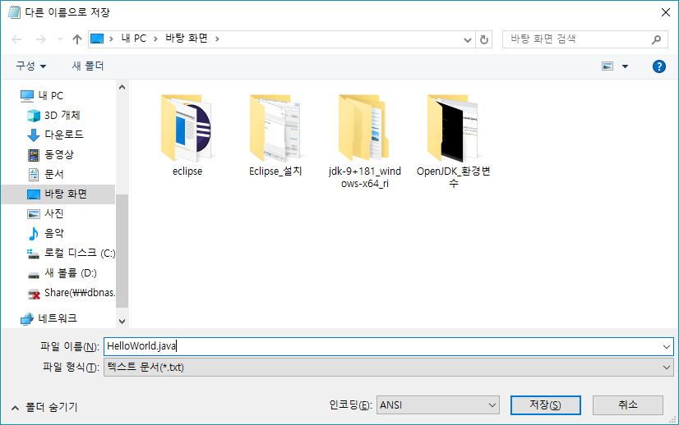
Add Java to the Windows Path
Save as a different name

Slide 20
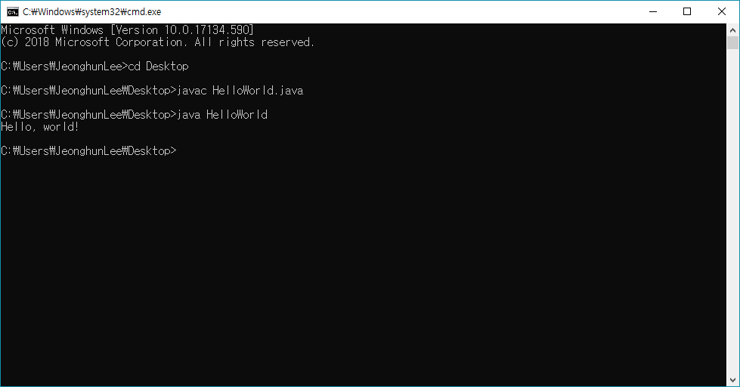
Add Java to the Windows Path
Java compile and run command line
javac HelloWorld.java
java HelloWorld
Can we only compile JAVA if we register an environment variable? NO. for CMD

Slide 21
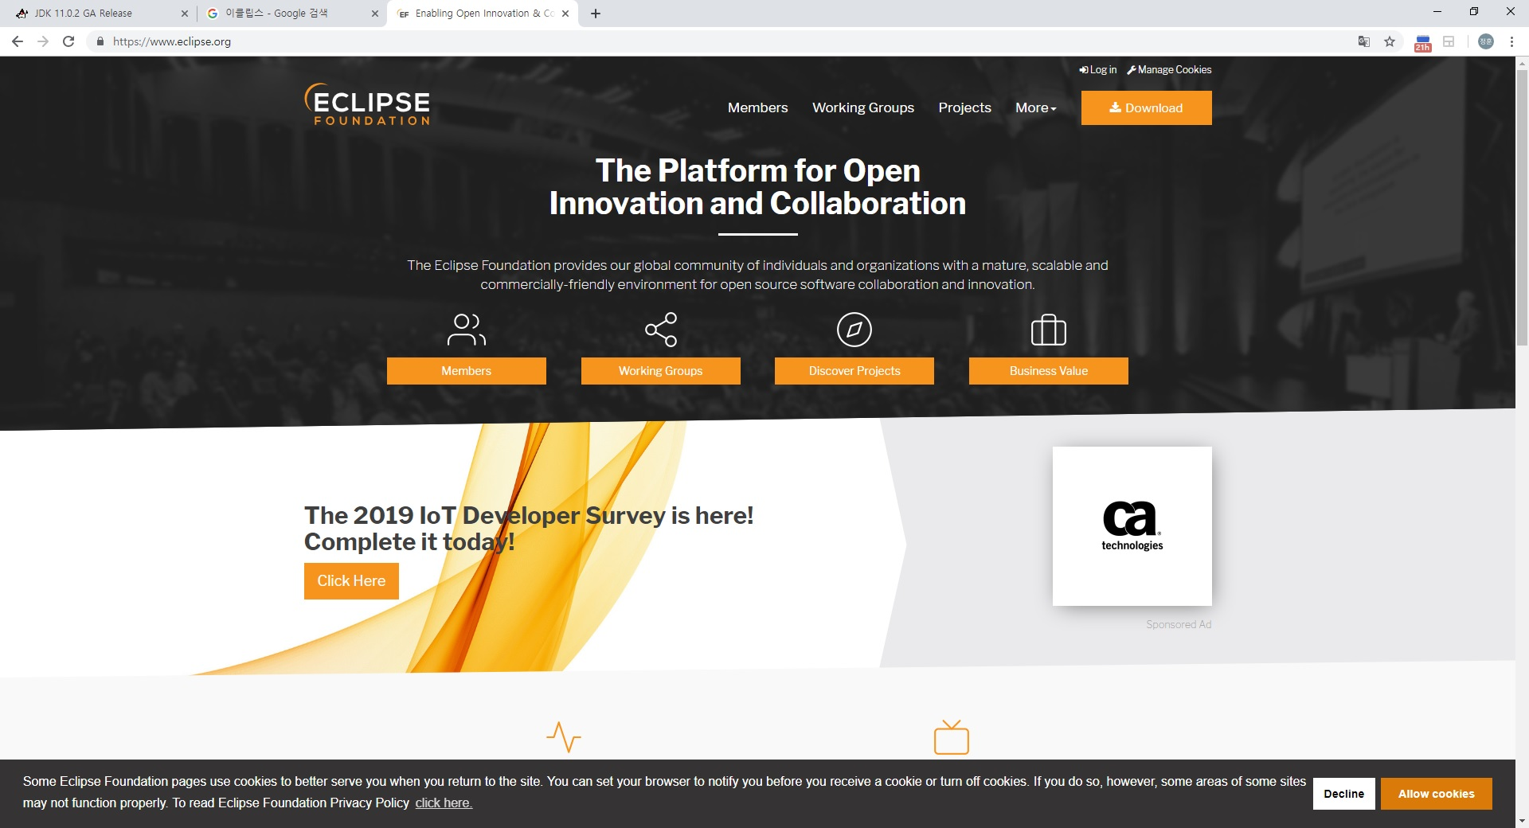
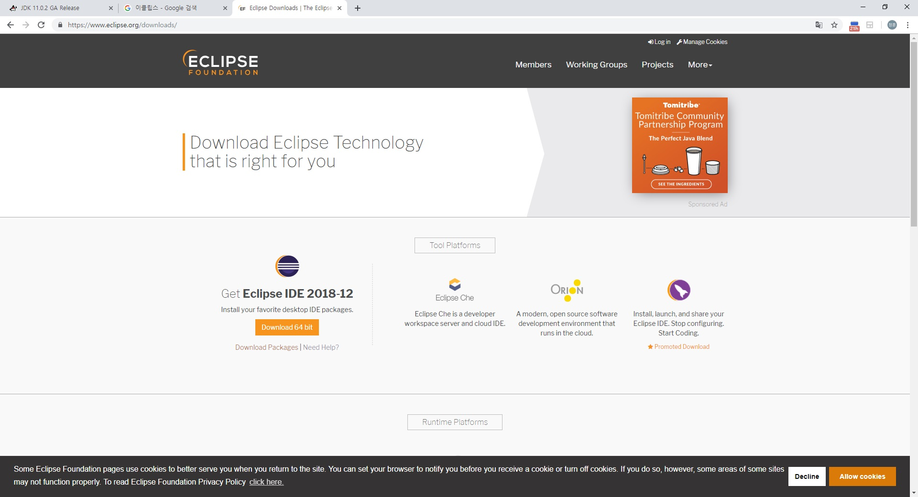
Install Eclipse
Go to Eclipse home page and select download menu
DOWNLOAD → DOWNLOAD Packages
(Eclipse: http://www.eclipse.org)

Slide 22
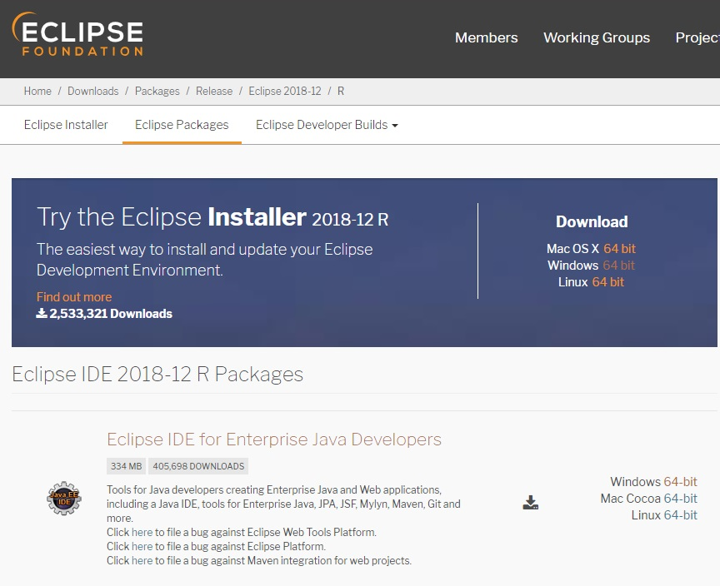
Install Eclipse
Go to Eclipse home page and select download menu
Eclipse IDE for Java Developers - Windows 64 bit
(Eclipse: http://www.eclipse.org/downloads/packages)

Slide 23
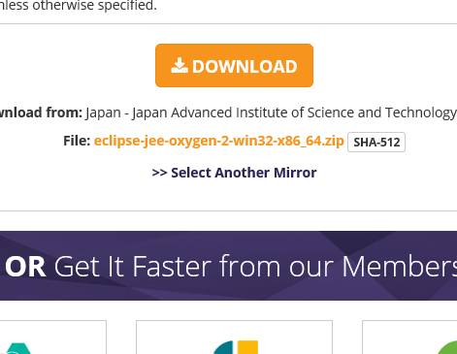
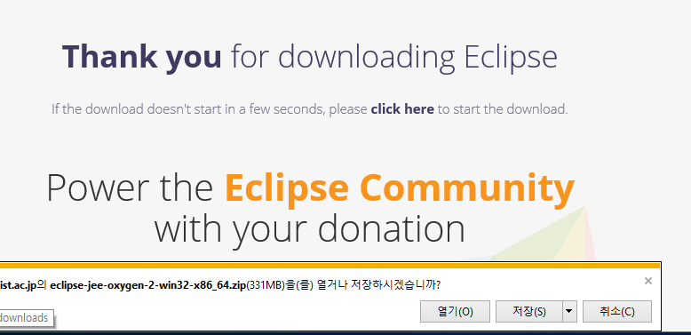
Install Eclipse
Go to Eclipse home page and select download menu
Eclipse IDE for Java Developers - Windows 64 bit

Slide 24
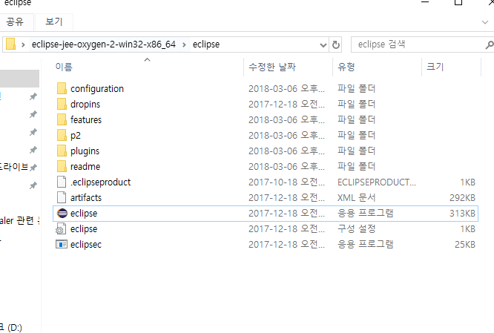
Install Eclipse
Click eclipse.exe icon

Slide 25
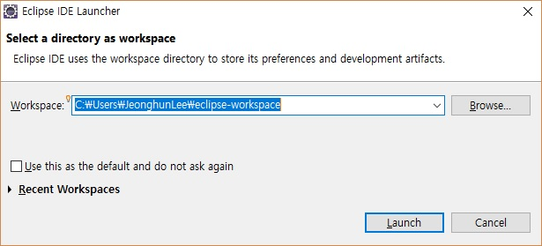
Intro into Eclipse
Start

Slide 26
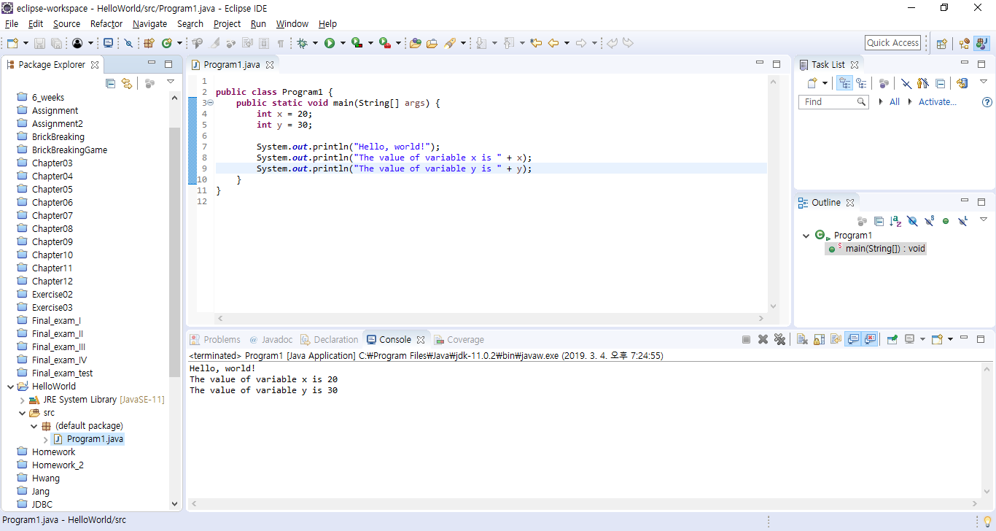
Running Eclipse
Main view of Eclipse IDE.
Task List
Package Explorer
Code View
Outline
Error logs, Documentations,
console,properties

Slide 27
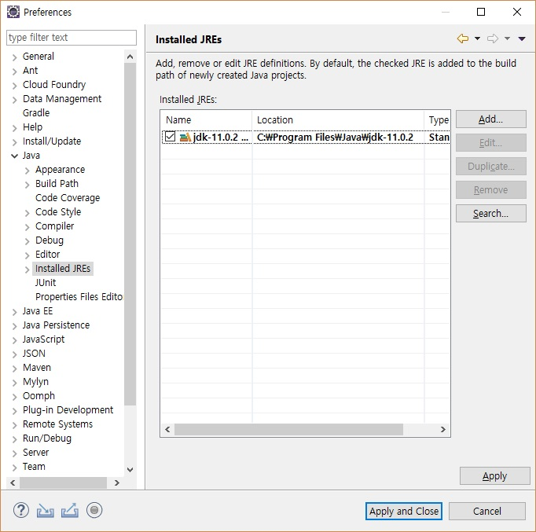
Running Eclipse
Window → Preferences

Slide 28
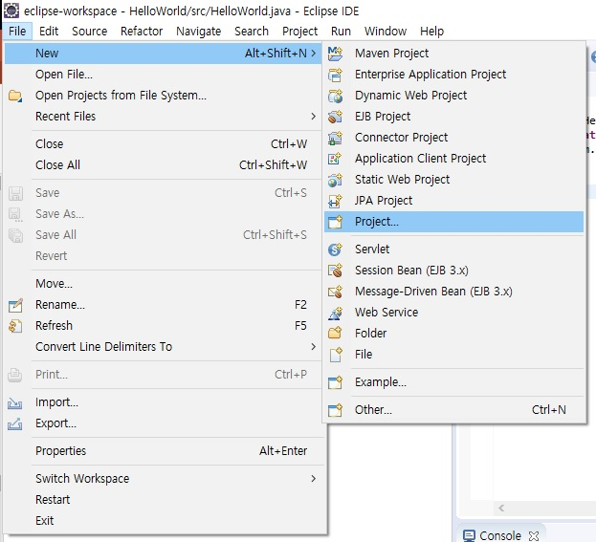
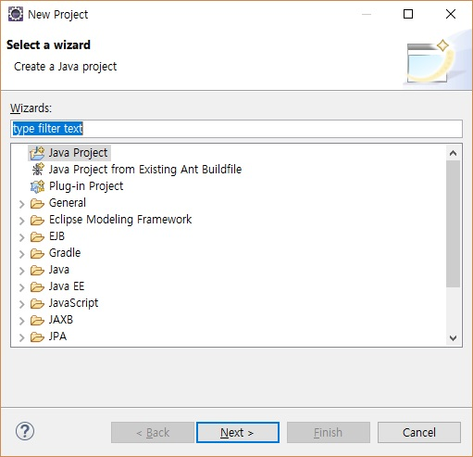
Running Eclipse
Create Project

Slide 29
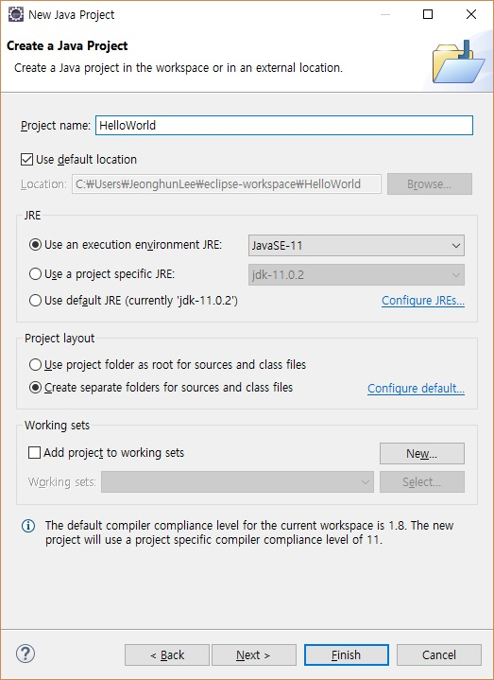
Running Eclipse

Slide 30
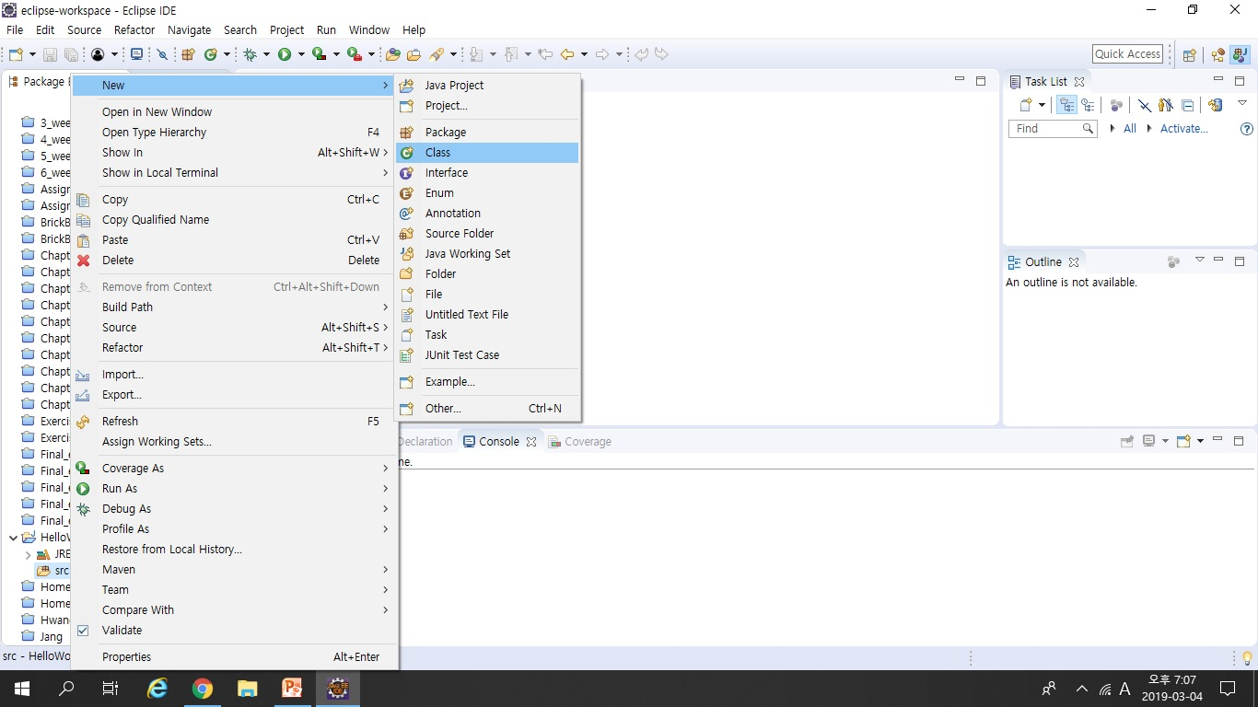
Running Eclipse
src 마우스 우클릭 → New → Class

Slide 31
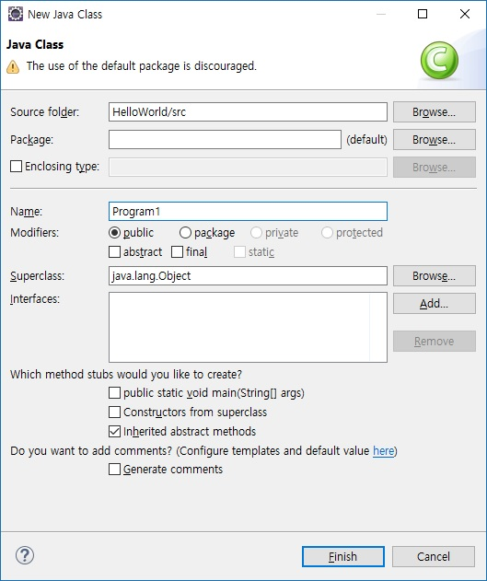
Running Eclipse

Slide 32
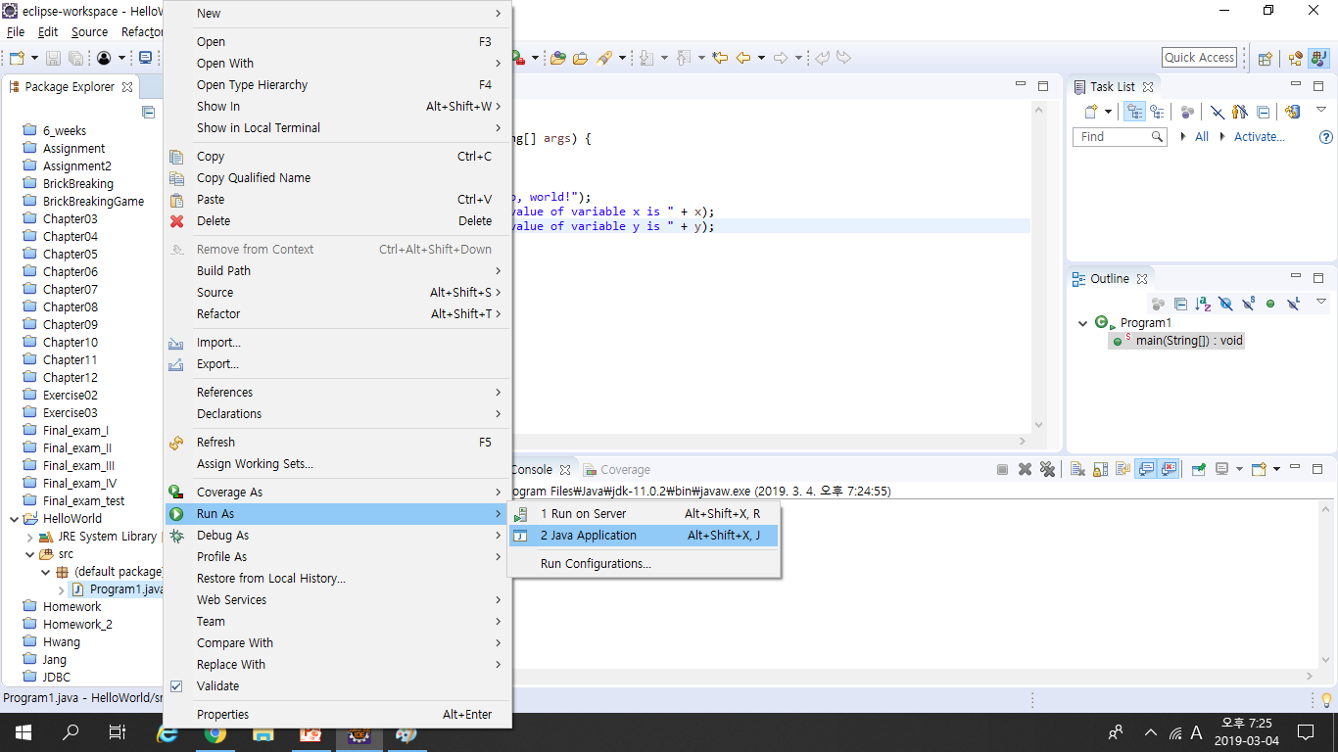
Running Eclipse

Slide 33
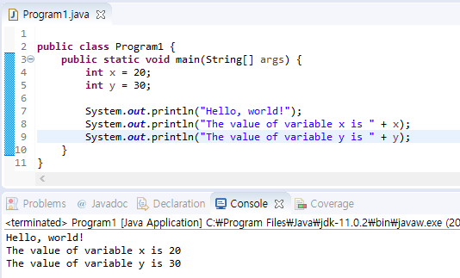
Running Eclipse
Console Output(System.out.println)

Slide 34
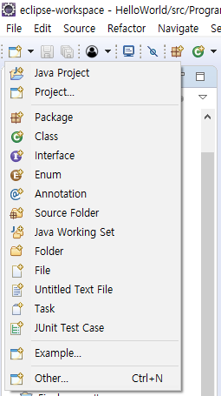
Creating Class in eclipse (Contd)
To create a class, simply click on the New button, then select Class

Slide 35
Creating a Class (continued)
This brings up the new class wizard
From here you can specify the following...
Package
Class name
Superclass
Whether or not to include a main
Other cool features
Fill in necessary information then click Finish to continue

Slide 36
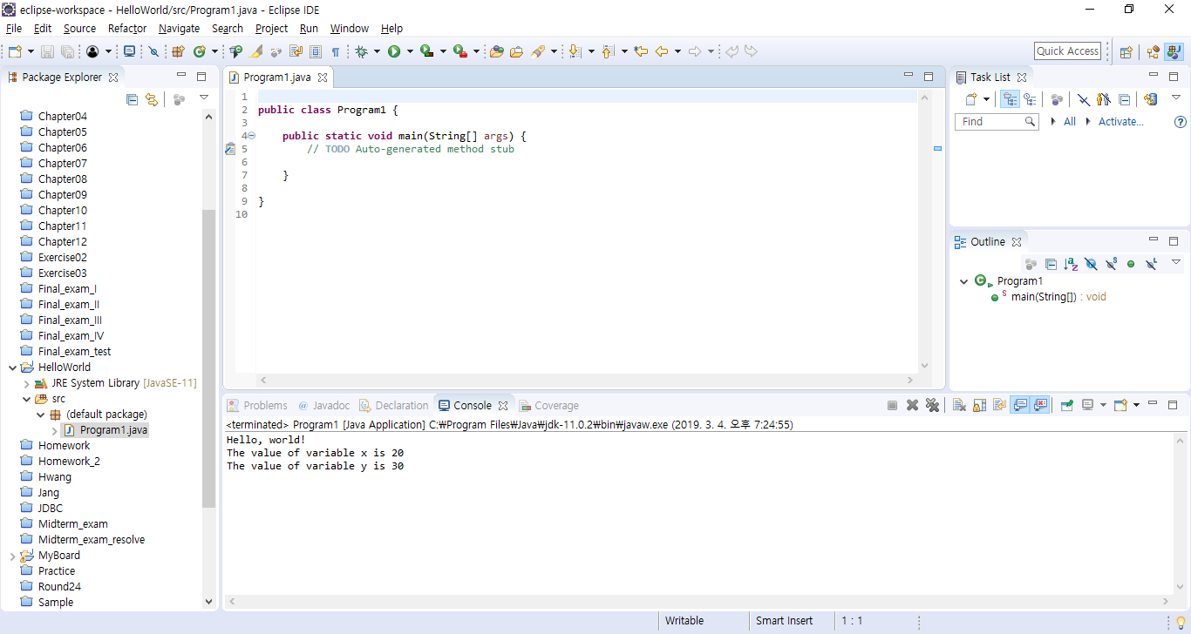
The Created Class
As you can see a number of things have now happened…
Source is loaded into the editor pane, already stubbed out
Source displayed in a hierarchical fashion listing each method name
Directory structure for package and actual java file created automatically

Slide 37
Compiling Source Code
One huge feature of Eclipse is that it automatically compiles your code in the background
You no longer need to go to the command prompt and compile code directly
This means that errors can be corrected when made
We all know that iterative development is the best approach to developing code, but going to shell to do a compile can interrupt the normal course of development
This prevents going to compile and being surprised with 100+ errors

Slide 38
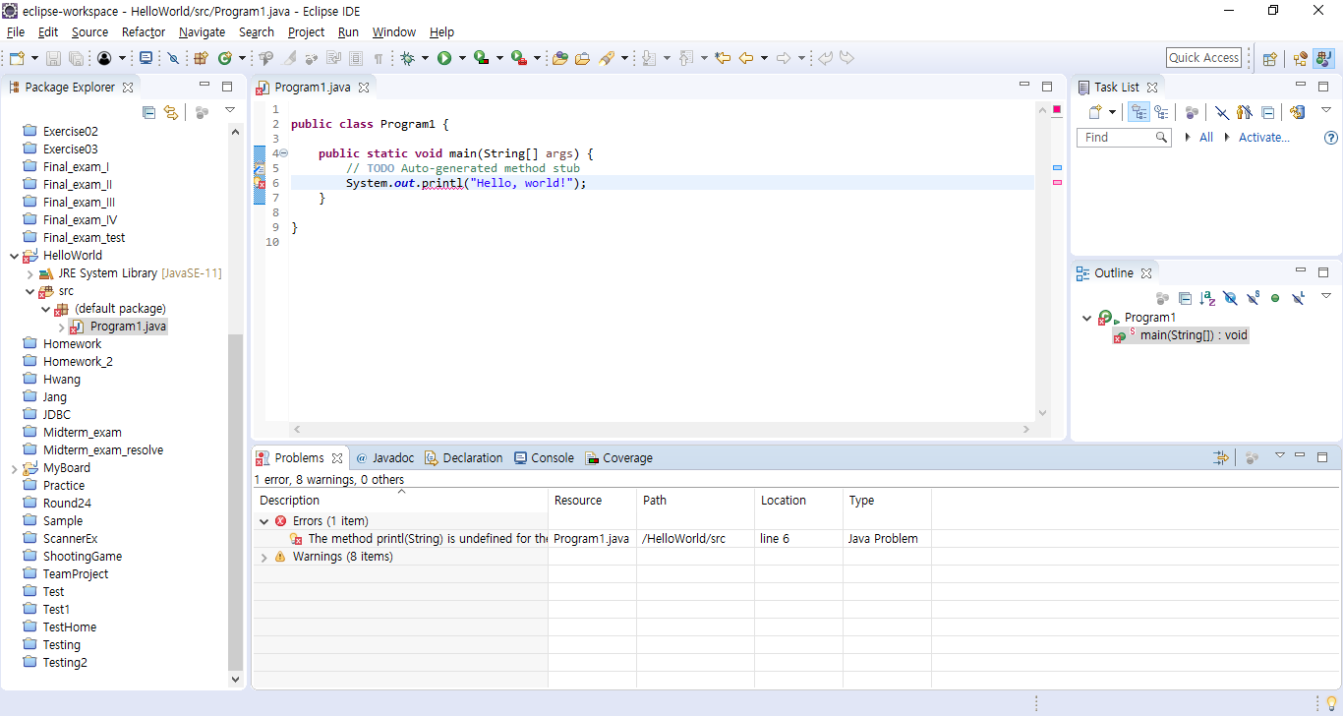
Example Compilation Error
This code contains a typo in the println statement…
Position in file is marked with a red line – 1 click allows you to jump to line with error
Packages/Classes with errors are marked with a red X
Error underlined with red squiggly line (just like spelling errors in many word processors)
Methods with errors are marked with a red X
Often Eclipse may have suggestions on how to fix the problem – if so, a small light bulb will be displayed next to the line of offending code
The Problems tab will contain a tabular representation of all errors across all files of all open projects

Slide 39
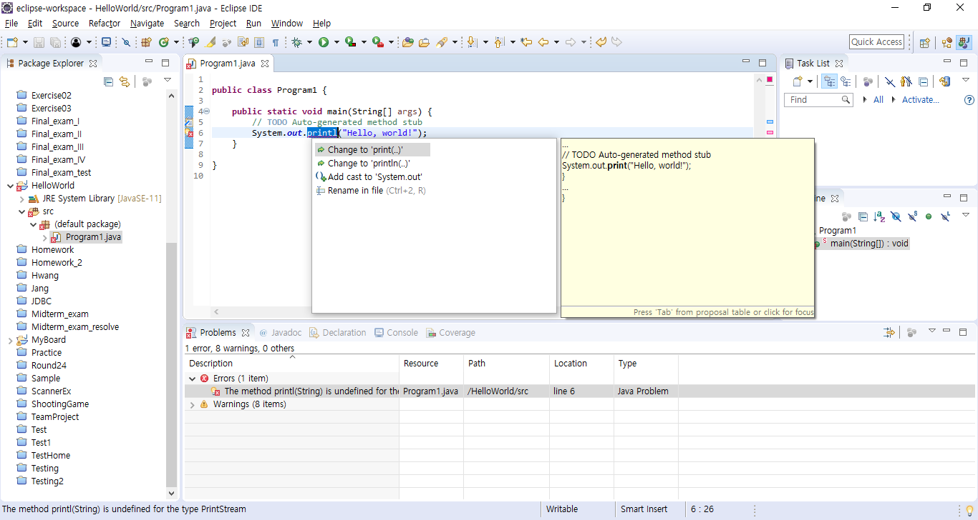
When clicking on the light bulb, Eclipse suggests changing printn to either print or println
Example Compilation Error (continued)

Slide 40
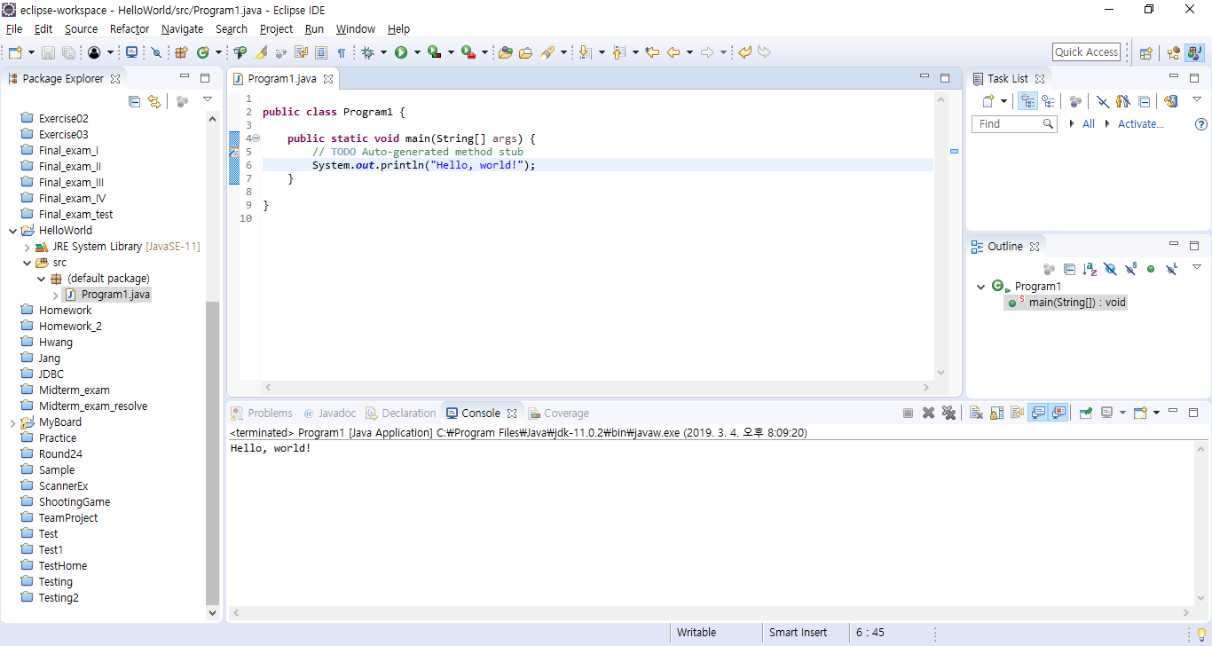
Running Code (continued)
The output of running the code can be seen in the Console tab in the bottom pane

Slide 41
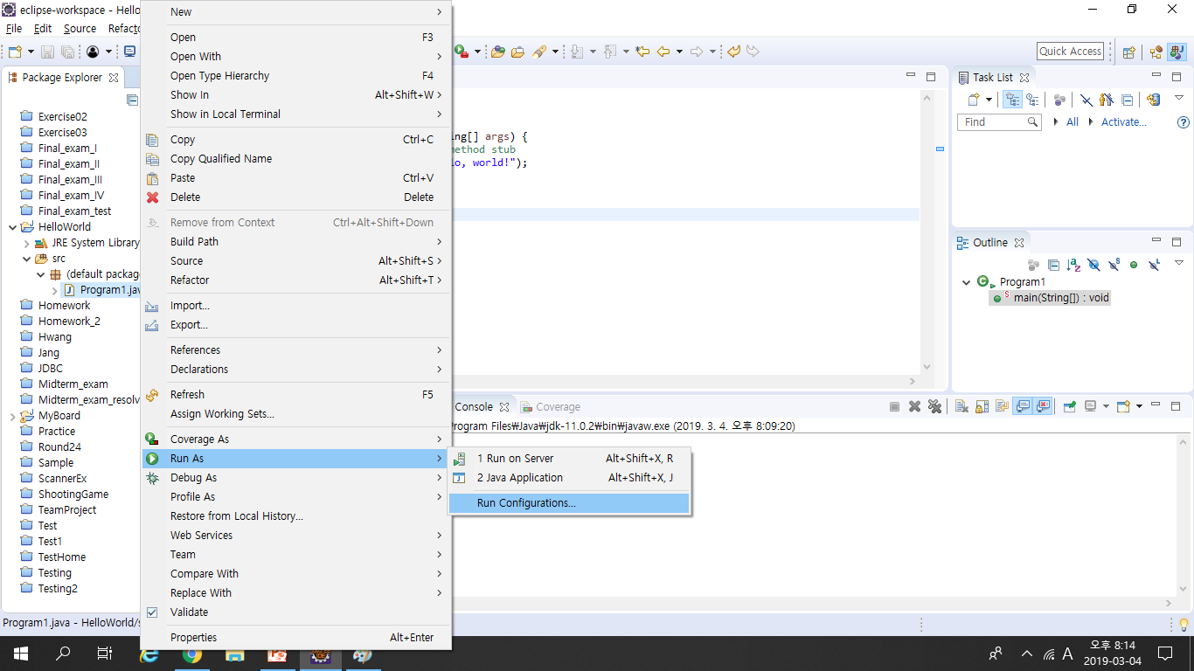
Run Configuration
Advanced options for executing a program can be found by right clicking the class then clicking Run As à Run…

Slide 42
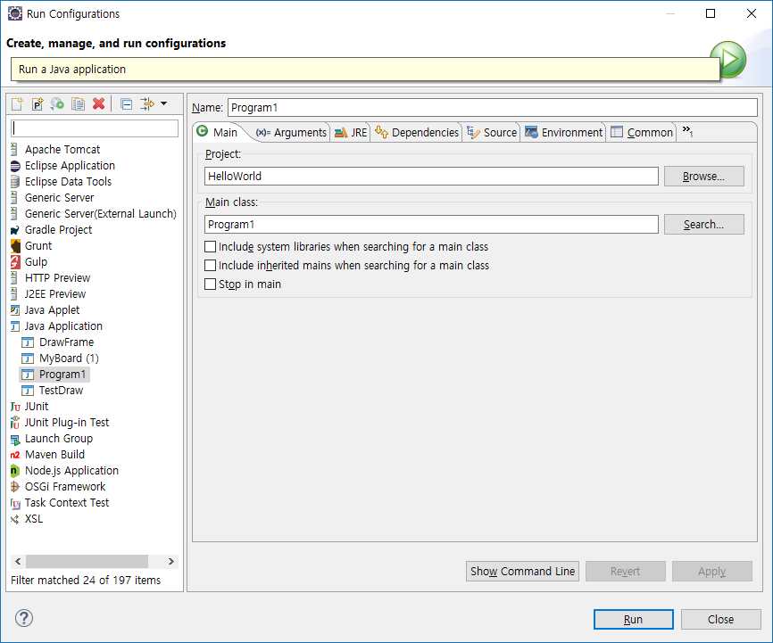
Run Configuration (continued)
Here you can change/add any of the following:
JVM arguments
Command line arguments
Classpath settings
Environment variables
Which JVM to use

Slide 43
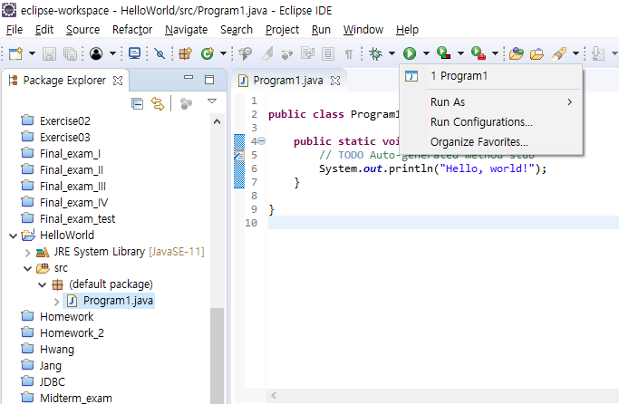
Re-Running Code
After you run the code a first time, you can re-run it just by selecting it from the run drop down menu

Slide 44
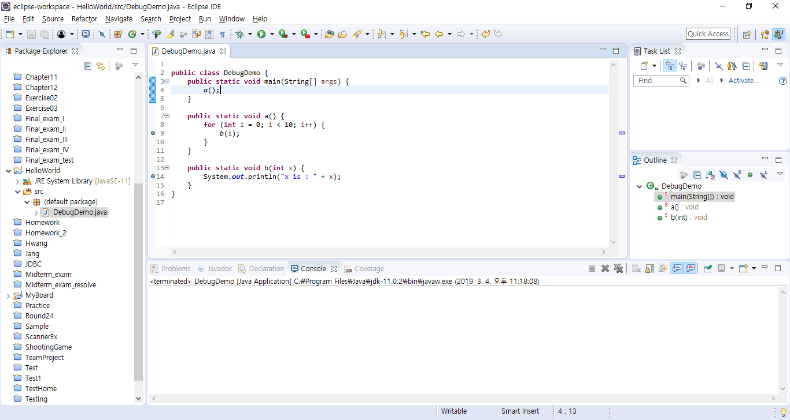
Debugging Code
Eclipse comes with a pretty good built-in debugger
You can set break points in your code by double clicking in the left hand margin – break points are represented by these blue bubbles

Slide 45
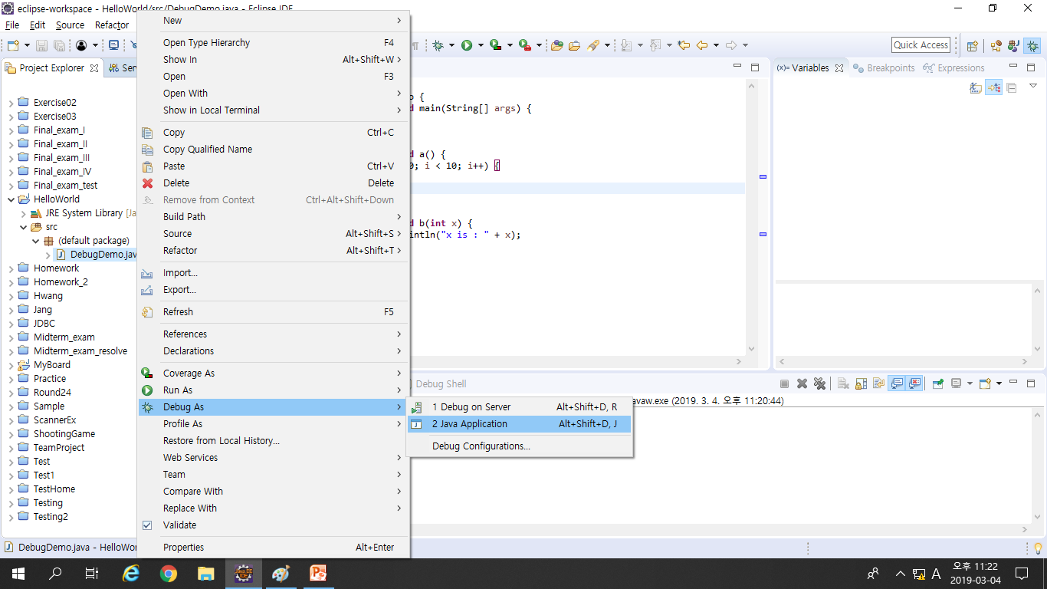
Debugging Code (continued)
An easy way to enter debug mode is to right click on the class and select Debug As à Java Application

Slide 46
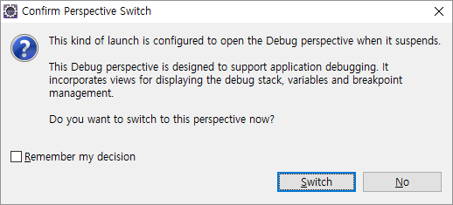
Debugging Code (Continued)
The first time you try to debug code you will be presented with the following dialog
Eclipse is asking if you want to switch to a perspective that is more suited for debugging, click Switch
Eclipse has many perspectives based on what you are doing (by default we get the Java perspective)

Slide 47
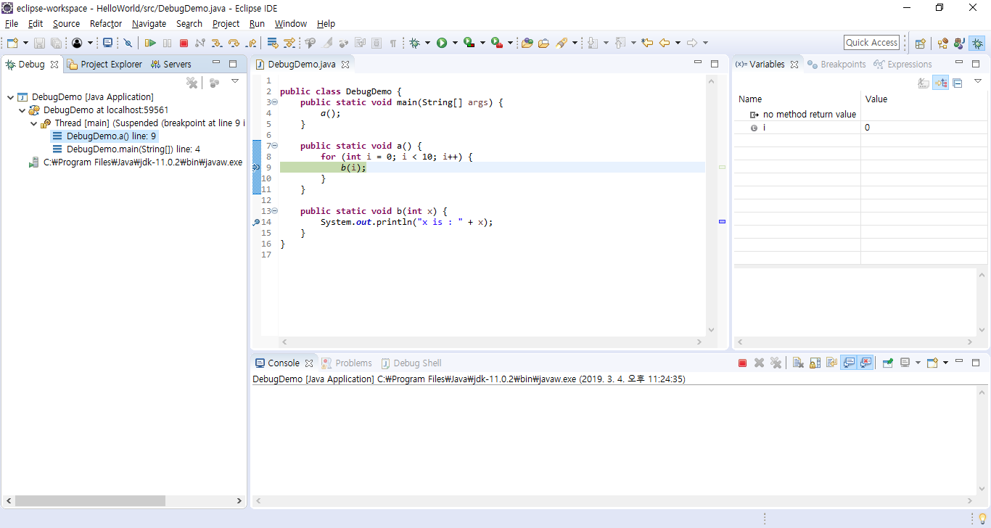
Debug Perspective
Note new Debug perspective – click Java to return to normal
These buttons allow you to step through the code
Variables in scope are listed here along with their current values (by right clicking you can change values of variables as you program is running)
List of breakpoints
This pane shows the current line of code we broke on
Output console, just like in normal run mode

Slide 48
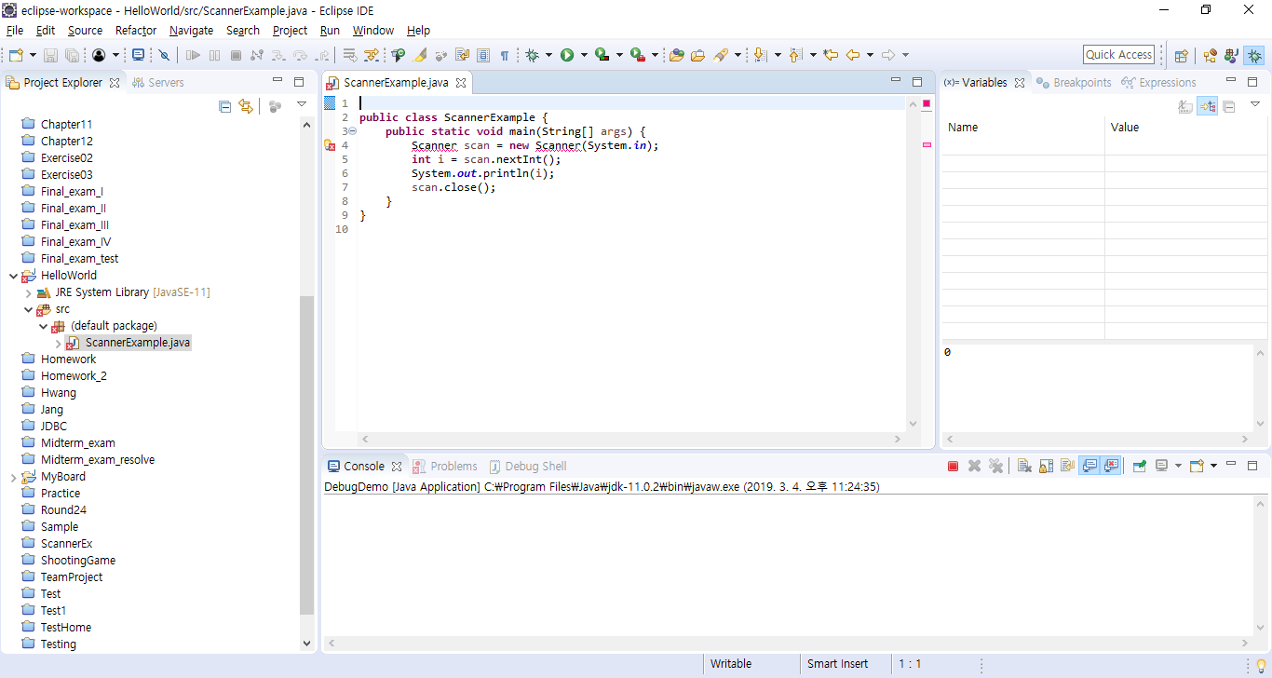
Import Organization
Eclipse can automatically include import statements for any classes you are using, just press Control + Shift + o (letter o)

Slide 49
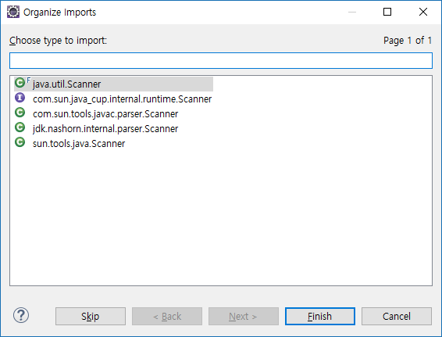
If the class is ambiguous (more than one in the API) then it will ask you to select the correct one
Import Organization (continued)

Slide 50
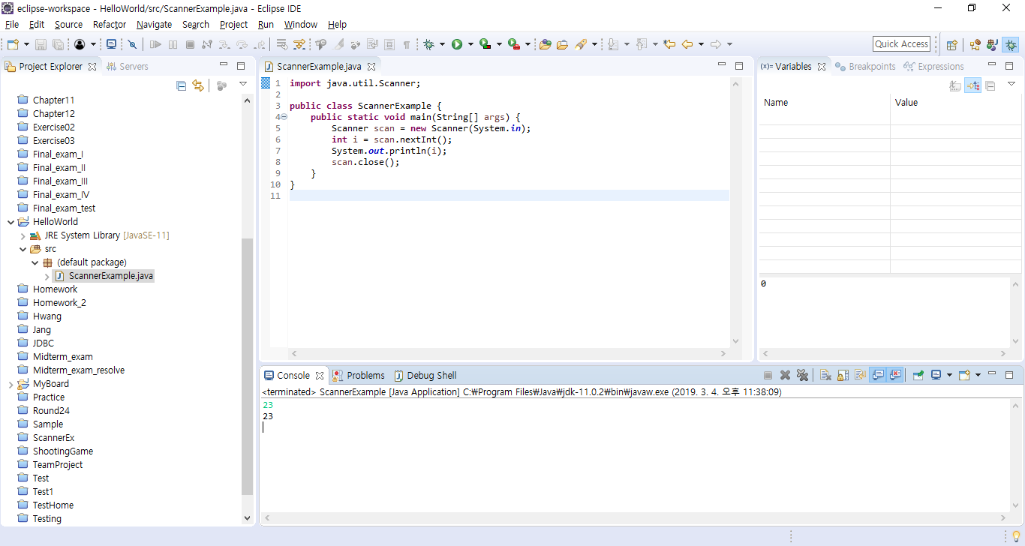
Import Organization (continued)
Import statements automatically included and organized
– You can organize imports to clean them up at any time

Slide 51
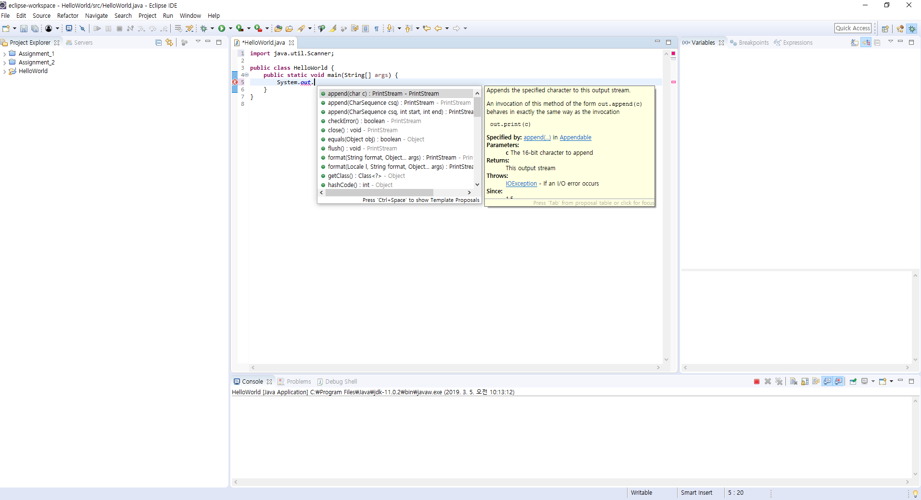
Context Assist
If you are typing and press a “.” character and pause a second, Eclipse will show you a list of all available methods for the class
–
– Get context assist at any time by pressing Control + Space
Prevents having to browse javadocs to see what methods are available

Slide 52

Q&A
Questions?

